Slide 1
Halloween recipe
cookbook
Holidays in English speaking countries - eTwinning project
our collaborative cook book

Slide 2
Creepy recipe
Creepy maffins

Slide 3
Pumpkin soup
Ingredients
2 sugar pumpkins (~2 1/4 cups (450 g)
pumpkin puree)
2 shallots, diced (~1/4 cup or 40 g)
3 cloves garlic, minced
2 cups (480 ml) of vegetable broth
1 cup (240 ml) of light coconut milk
2 Tbsp of honey
1/4 tsp each sea salt, black pepper,
cinnamon, sesam seeds
Instructions
1. Preheat oven to 176 C and line a baking sheet with parchment paper.
2. Cut off the tops of 2 sugar pumpkins and then halve them. Use a sharp spoon to scrape out all of the seeds and strings.
3. Brush the flesh with oil and place face down on the baking sheet. Bake for 45-50 minutes. Remove from the oven, let cool for 10 minutes, then peel away skin and set pumpkin aside.
4. To a large saucepan over medium heat add 1 Tbsp olive oil, shallot and garlic. Cook for 2-3 minutes, or until slightly browned and translucent. Turn down heat if cooking too quickly.
5. Add remaining ingredients, including the pumpkin, and bring to a simmer.
6. Use a blender to puree the soup. Pour mixture back into pot.
7. Continue cooking over medium-low heat for 5-10 minutes and taste and adjust seasonings as needed.
8. Add sesam seeds and add a pinch of salt and cover to steam.
9. Enjoy your tasty autumn soup!
Liza Shliakhetko and Nastia Cho
Cherkasy Collegium “Berehynia” (Ukraine)

Slide 5
HALLOWEEN PIZZA
Ingredients (for 4 people):
Pizza dough
250 g of minced meat
100 ml sauces
50 g of corn
25 ml of water
100 g of grated cheese
yellow and green peppers, sliced ​​black olives, mini tomato slices
salt, pepper
Preparation:
Heat the oven to 230 degrees. Grate the baking sheet and spread the pizza dough on the sheet. In a pan, fry the beef until it reaches the brown color. Add salsa, corn and water. After everything is finished, remove from the fire and arrange for a pizza dough. Spread with the cheese and then stuff the other ingredients. Bake 15-20 minutes.

Slide 6
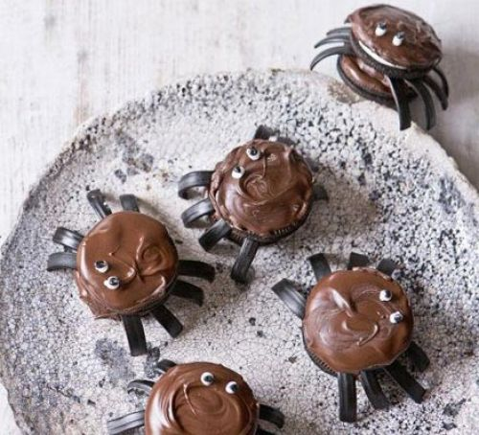
Chocolate cookies 'Spiders’
Ingredients
· 200g dark or milk chocolate, broken into chunks
· 113g pack liquorice
· 2 x 154g packs Oreo cookies
· white and black icing pens
· Instructions
1.Melt the chocolate in a heatproof bowl over a pan of barely simmering water. Once melted, turn off the heat and leave the chocolate in the bowl to keep warm while you assemble the spiders.
2. Melt the chocolate in a heatproof bowl over a pan of barely simmering water. Once melted, turn off the heat and leave the chocolate in the bowl to keep warm while you assemble the spiders.
3. Melt the chocolate in a heatproof bowl over a pan of barely simmering water. Once melted, turn off the heat and leave the chocolate in the bowl to keep warm while you assemble the spiders.
4. Use the icing pens to add eyes, by first blobbing two big dots of white icing on each, topped with two smaller dots of black icing.

Slide 7
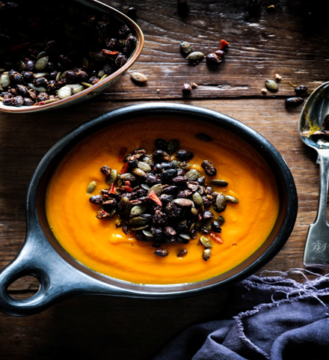
Carrot, Pumpkin and Turmeric Soup
Makes: 4 bowls
Prep time: 10 minutes Cook time: 30 minutes
1 kg pumpkin, skin removed, chopped
4 carrots, chopped
4 cloves garlic, crushed
1 large piece of fresh ginger (approx 8cm), chopped
1 knob of fresh turmeric or 2 tsp ground turmeric
4 cups of water
salt and pepper to season
Place the chopped pumpkin, carrot, garlic, ginger, turmeric
and water in a large saucepan and bring to the boil.
Turn the heat down and simmer approximately 20-30
minutes until the carrots and pumpkin can be cut easily
with a butter knife. Turn off the heat and leave to cool.
When cool enough to handle, blend using either a stick
blender, food processor or high speed blender until smooth.
Ilona Kozulia, Cherkasy Collegium ‘Berehynia’, Ukraine
Spicy Black Bean Topping
Prep time: 5 minutes
Cook time: 10 minutes
2 cloves of garlic, crushed
1 red chilli, deseeded and chopped
1/2 cup pumpkin seeds
1/2 tsp paprika
1/2 tsp cumin
1/4 tsp mixed herbs
pinch cayenne pepper
1 x 400g can of black beans, drained
and rinsed
salt and pepper to season
coconut oil for cooking
Heat a couple of tablespoons of oil in a fry pan and add the garlic and chilli. Cook until the garlic starts to brown, then add the pumpkin seeds and spices. Continue cooking on medium heat until the pumpkin seeds start to pop (approximately 5 minutes), then add the drained black beans and stir gently until they are heated through. Season with salt and pepper.
To serve, ladle warm soup into a bowl and top with a few generous spoonfuls of black bean topping.

Slide 8
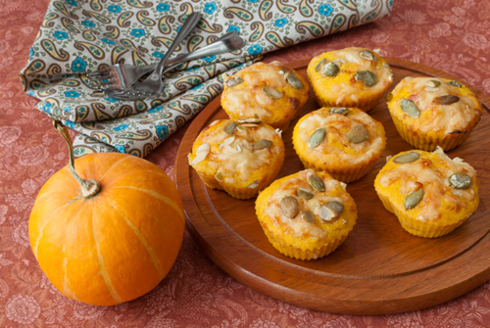
Cream Cheese Pumpkin Muffins
Ingredients
2 1/4 cup flour
2 1/2 tsp. baking powder
2 tsp. pumpkin pie spice
3/4 tsp. salt
1 cup milk
3/4 cup solid-packed pumpkin
1/2 cup solid-packed dark brown sugar
4 tbsp. melted butter
2 tsp. vanilla extract
2 large eggs
1/2 cup pecans, coarsely chopped
Cream Cheese Filling
4 oz. cream cheese, at room temperature
2 tbsp. butter, at room temperature
1 c. confectioners’ sugar
1 tsp. vanilla extract
Directions
1. Preheat oven to 375°F. Grease twelve 2½ x 1¼-inch muffin-pan cups, or line with cupcake liners.
2. In large bowl, combine flour, baking powder, pumpkin pie spice, and salt. In medium bowl with wire whisk, mix milk, pumpkin, brown sugar, melted butter, vanilla, and eggs until blended. Stir flour mixture into pumpkin mixture until just moistened.
3. Spoon batter into muffin-pan cups.
4. Sprinkle tops with chopped pecans.
5. Bake until toothpick inserted in center of muffin comes out clean, or about 25 to 30 minutes. Immediately remove from pan. Cool completely on wire rack.
6. Meanwhile, prepare cream cheese filling: Using electric mixer, beat cream cheese and butter. Gradually beat in confectioners’ sugar and vanilla extract until light and fluffy.
7. Fit a piping bag or heavyweight food storage bag with a plain writing tip. Fill bag with frosting. With paring knife, make a small slit in bottom of muffin. Insert pastry tip about ½ inch into muffin. Squeeze in about 1 tablespoon filling. Repeat to fill all muffins.

Slide 9
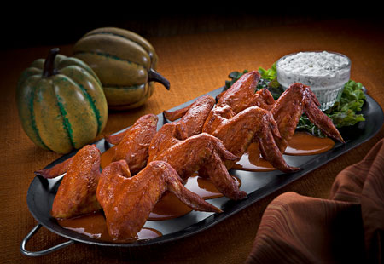
Bat Wings
Ingredients
1 cup white sugar
1 cup soy sauce
1 dash garlic powder
1 kg chicken wings
Instruction
1. Preheat an oven to 190 degrees C; prepare a glass baking dish.
2. Whisk together the sugar, soy sauce, and garlic powder in a medium bowl. Arrange the wings in the bottom of the prepared dish; pour the soy sauce mixture evenly over the wings.
3. Bake in the preheated oven for 20 minutes; turn the wings over with a spatula and cook another 20 minutes.

Slide 10
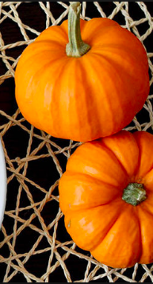
Emiliana Rufo
Ingredients:
1 package crescent rolls
8 Hot dogs
Mustard
Preheat oven to 180° C.
Unwrap the crescent rolls to make four rectangles.
Using a pizza cutter or a knife, slice dough into thin strips, about 3-4 cm wide.
Wrap the crescent roll dough strips around hot dogs, leaving room near the top for the mummy face. Bake for 14 to 16 minutes until dough is golden brown.
Just before serving, squirt a little mustard on a plate. Dip a toothpick in the mustard and use it to make a mummy face on the hot dogs.
This is our favourite Halloween recipe! Easy to prepare for kids…
Notes:
Emiliana Rufo - I.C. Parco di Veio - Rome, Italy - Class 1C s.y.2018/2019

Slide 11
Fatma Kul
Ingredients
2 kg of pumpkin
2.5 glass of sugar
some walnut,piu7stachio
Peel the pumpkin.Slice it.Spread the sugar on it.Let it wait for one hour in a sauce pan.Then cook it 20-25 minutes with low heat.Turn off the cooker.Let it cool for a while.Sprinkle sone walnut and pistachio on it.Enjoy your meal.

Slide 12
HARIKLIA KOUKARA
BLOODY FINGER HOT DOGS
INGREDIENTS
a pack of hot dogs
a knife
ketchup
buns
Bring your water to a boil, toss the hot dogs in and allow to cook for about 4 minutes. Take out of water and using a sharp knife cut knuckle lines in the hot dogs. Also cut a nail bed into the top of the hot dog. Serve on hot dog buns that have been smeared with ketchup to look like blood.

Slide 13
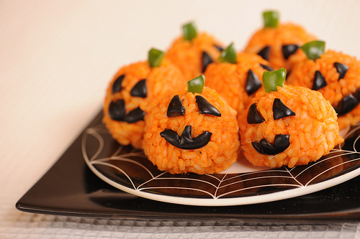
Hatun Altunöz RICE BALLS - HALLOWEEN
Take rice, carrot juice, salt and water into a pot and boil for 15 minutes.
Then leave to cool to room temperature.
After the rice has cooled, create small balls, rolling in your hand.
Create the eye and mouth shape by cutting the olives.
Cut the green pepper into small pieces and create hair for the pumpkin
Ingredients :
half of a water glass rice,
two cups of carrot juice,
a cup of water,
Half a teaspoon of salt,
Olive
Green pepper

Slide 14
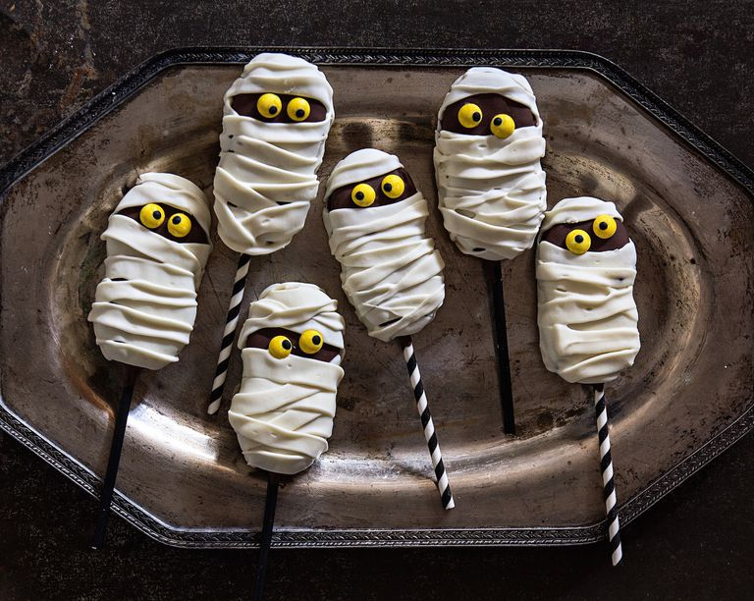
Mummy Poops
DIRECTIONS
Line a baking sheet with parchment paper. Lightly dip straws or lollipop sticks into chocolate before topping on open Nutter Butter. Press cookie back together, then dip into melted chocolate until completely coated. (Allow excess chocolate to drip back into pan.)
Place dipped cookie onto prepared baking sheet to set, about 25 minutes (to speed up the process, transfer pops to the refrigerator for 10 minutes).
Fill a pastry bag fitted with a straight flat tip with buttercream and pipe from side to side. Fill another bag with chocolate, lightly cover backside of M&M's minis, and press onto cookie pops. Dot each M&M with chocolate to finish eyes.
Set aside at least 1 hour to fully set.
INGREDIENTS
8
straws or lollipop sticks
100g chocolate, melted
8 Nutter Butters, opened
1 cup buttercream frosting
(homemade or store bought)
M&M's Minis, for decorating

Slide 15
Creamy Pumpkin Soup with Grilled Cheese Croutons
Rich and creamy pumpkin soup with grilled cheese croutons is the ultimate quick and simple
30-minute Fall dinner
Ingredients
3 cups vegetable or chicken broth
2 cups pumpkin puree (not pumpkin pie filling)
1 1/2 teaspoons McCormick Garlic Powder
1 1/2 teaspoons McCormick Onion Powder
1/4 teaspoon McCormick Ground Ginger
2 tablespoons sugar
1 teaspoon salt (or to taste)
1/4 teaspoon black pepper (or to taste)
1 1/2 cups heavy cream (see note)
4 slices white bread
4 tablespoons butter, softened
4 slices provolone cheese
1/3 cup crumbled goat cheese
fresh basil, for topping
Instructions
1. In a large pot whisk together broth, pumpkin, garlic powder, onion powder, ground ginger, sugar, salt, and pepper and bring to a boil over high heat.
2. Once boiling, stir in heavy cream. Reduce heat to medium and simmer 5-10 minutes longer.
3. While soup is simmering, prepare the croutons. Butter one side of each slice of bread, on opposite side place one slice of provolone, top with goat cheese crumbles, then another slice of provolone and top with second slice of buttered bread. Cook in a lightly greased pan over medium-high heat 3-4 minutes on each side until cheese is melty. Cut into 1-inch pieces.
4. Serve soup hot, topped with cracked black pepper and fresh basil and serve with grilled cheese croutons.
Recipe Notes
For a lighter soup, substitute heavy cream for 1 cup half and half + 1/2 cup heavy cream. Note that the result will be on the lighter side, but not as creamy.
Yaroslav Slobodianiuk, Cherkasy, Ukraine

Slide 16
Nicoleta Verman
Desert with eyes
Ingredients 250g mascarpone, 250 ml sweet cream for whipped cream, 2 tablespoons of sugar, a few drops of yellow or orange dye, a chocolate biscuit package, 8 white mints some dark chocolate melted
Method of preparation : Beat the sour cream to make the foam, then incorporate it lightly into mascarpone. Add the dyestuff and stir until homogenized Choose 4 cups for dessert and put each layer of this mixture, then another layer of cracked biscuits, and a last layer of mascarpone cream. For decoration add 2 glasses (2 beads) to each glass, and the bears decorate them with a drop of black chocolate. Thus the eyes will be more real.
Good appetite!
Student Andreea Sandu

Slide 17
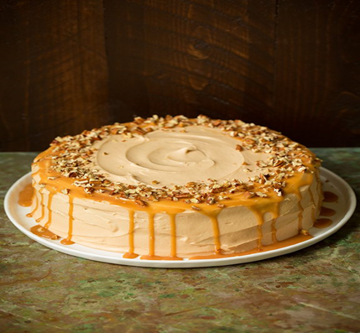
Browned Butter Pumpkin Cake with Salted Caramel Frosting
Ingredients
Cake
1 cup unsalted butter, diced into 1 Tbsp pieces
2 1/4 cups (315g) all-purpose flour
1 tsp baking powder
1 tsp baking soda
1/2 tsp salt
1 1/2 tsp ground cinnamon
3/4 tsp ground ginger
1/4 tsp ground nutmeg
1/4 tsp ground cloves
1 1/2 cups (324g) granulated sugar
4 large eggs
1 tsp vanilla extract
1 2/3 cups (395g) canned pumpkin puree
1/4 cup (60ml) buttermilk
Caramel sauce
1 cup (210g) granulated sugar
1/4 cup water
3/4 tsp fine sea salt
1/4 cup unsalted butter
2/3 cup (160 ml) heavy cream
Frosting
3/4 cup unsalted butter
3 1/4 cups (375g) powdered sugar
1 tsp vanilla extract
1/2 cup caramel sauce (from above)
1/4 tsp fine sea salt or to taste
Chopped pecans for garnish (optional)
Instructions
For the cake:
1. Add butter to a medium saucepan set over medium heat. Melt butter and allow to brown,
whisking occasionally. Pour into a 4 cup bowl and allow to cool in refrigerator until creamy
and nearly set, stirring occasionally, about 2 hours. Alternately, chill fully overnight, then let
rest at room temp until softened, about 20 - 30 minutes.
Preheat oven to 200 degrees. Butter two cake pans, line with a round of parchment, butter parchment and lightly dust pans with flour, shaking out excess. Wrap cake pans with cake strips if you have them. In a medium mixing bowl whisk together flour, baking powder, baking soda, salt, cinnamon, ginger, nutmeg and cloves for 20 seconds.
In the bowl of an electric stand mixer fitted with the paddle attachment (I recommend using an attachment that constantly scrapes sides and bottom of bowl, otherwise stop mixer occasionally throughout entire mixing process and scrape down sides and bottom of bowl), whip together cooled browned butter with 1 1/2 cups granulated sugar until pale and fluffy. Mix in eggs one at a time adding in vanilla with last egg. In a bowl or liquid measuring cup mix together pumpkin and buttermilk. With mixer set on low speed add in 1/3 of the flour mixture (to the butter mixture) and mix just until combined then add in 1/2 of the pumpkin mixture and mix just until combined. Repeat process once more with flour and pumpkin mixture then finish by mixing in last 1/3 of the flour mixture until nearly combined, then stop mixer and fold batter with a spatula to evenly incorporate. Divide batter among two prepared baking pans and spread batter into an even layer. Bake in preheated oven 25 - 30 minutes until toothpick inserted into center comes out clean. Meanwhile prepare and chill caramel sauce.
For the caramel sauce:
Have all caramel ingredients ready. In a medium saucepan combine sugar, water and sea salt. Set over medium-high heat and whisk constantly until it begins to boil, then allow mixture to boil until it turns to a rich amber color, carefully swirling pan occasionally. Immediately whisk in butter then remove from heat and whisk in cream (be careful, it will steam! A long handled whisk is recommend) and stir until smooth. Allow to cool several minutes then pour into a glass bowl or jar and chill caramel until completely cooled.
For the frosting:
Whip butter until light and fluffy. Add powdered sugar, 1/2 cup of the cooled caramel sauce, sea salt and vanilla. Mix until well combined and slightly fluffy. Chill until it becomes a more firm consistency if needed. Spread over cake and drizzle some of the remaining caramel sauce over cake just before serving. Sprinkle with pecans if desired.

Slide 18
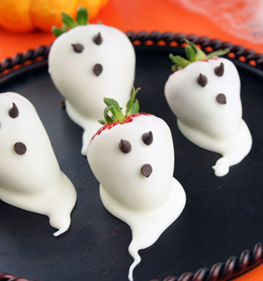
STRAWBERRY GHOSTS
INGREDIENTS:
strawberries white chocolate mini chocolate chips
DIRECTIONS:
Melt the white chocolate. Dip the strawberries in the melted chocolate, slide the strawberry back and set on a wax paper to dry. Place two mini chocolate chips for the eyes and one for the mouth.
by Stefania Rigo and class 4A, Pieve di Soligo, Italy

Slide 19
Svitlana Lenarska

Slide 20
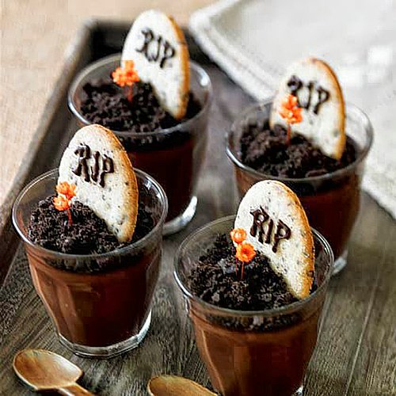
Dead Pudding
Ingredients:
corpse sugar
chocolate milk
flour biscuits
Directions:
Put two glasses of milk and add a glass of sugar and flour. After use a mixer
to blend. Lastly add some corpse and cook. After your preparation completed
pour them into cups. Finally put the biscuits and chocolate to decorate.

Slide 21
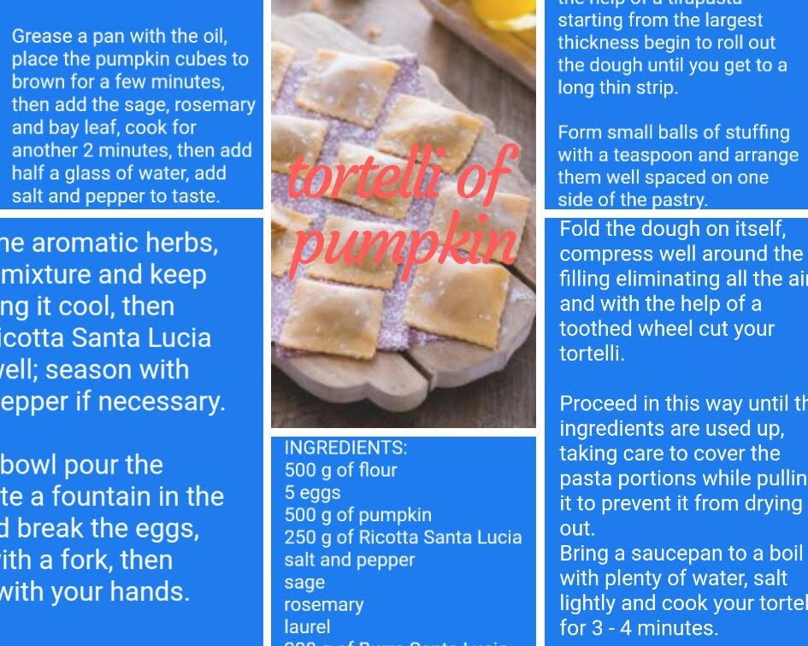
ISC LUCIANI - ASCOLI PICENO - FEDERICO 3F

