Slide 1
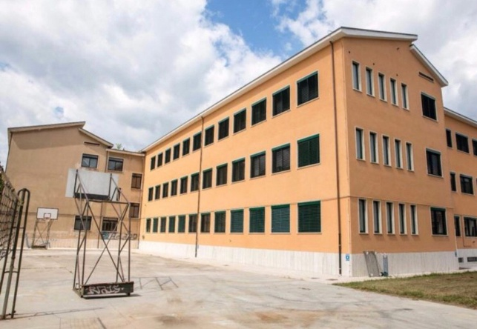
“VIRTUAL TOUR GUIDES”
Ascoli Piceno - ITALY
Vincenza Agostini

Slide 2
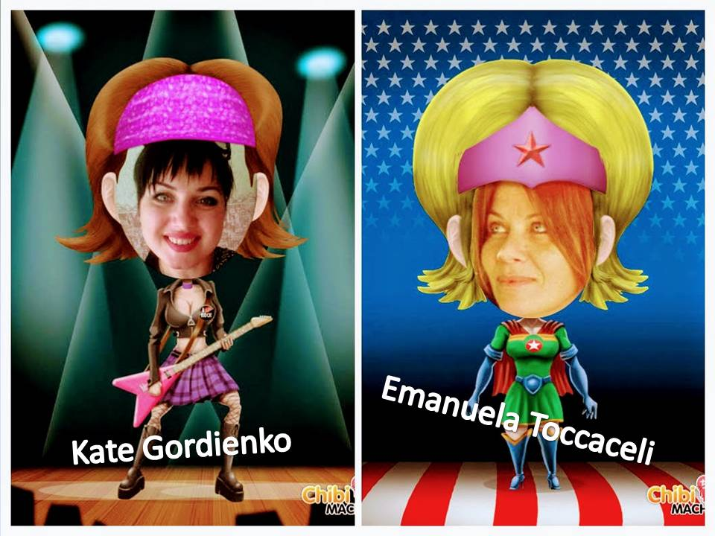
Slide 1 “VIRTUAL TOUR GUIDES”
A project realized with the idea of giving entrepreneurship skills to students, not only in a specific territory, but especially in relation to other European “areas”.
https://youtu.be/ZGfdpUMkMq8
Co - founders
https://youtu.be/xYb9MgMLoP4
ITALY
UKRAINE

Slide 3
Slide 2 “VIRTUAL TOUR GUIDES”
A project for TEACHERS AND STUDENTS
- TEACHERS : lessons, materials, tests, school curriculum, rubrics
- STUDENTS: letters, gifts, postcards, cards, emails, short personal messages, discussions, play online games (kahoot, mentimeter, minecraft-cospaces edu), share videos, songs.
_______________ THE PROJECT___________________________________________
- 1^{st task} : CREATE GROUPS, DECIDE WEBTOOLS AND ESTABLISH OUR NETIQUETTE https://youtu.be/of8WuhCXFQc
- 2nd task: HIRE TOUR GUIDES in Lyman and in Ascoli
-3rd task: OPEN TWO VIRTUAL BUREAUX on the twinspace
ONE IN LYMAN AND ONE IN ASCOLI

Slide 4
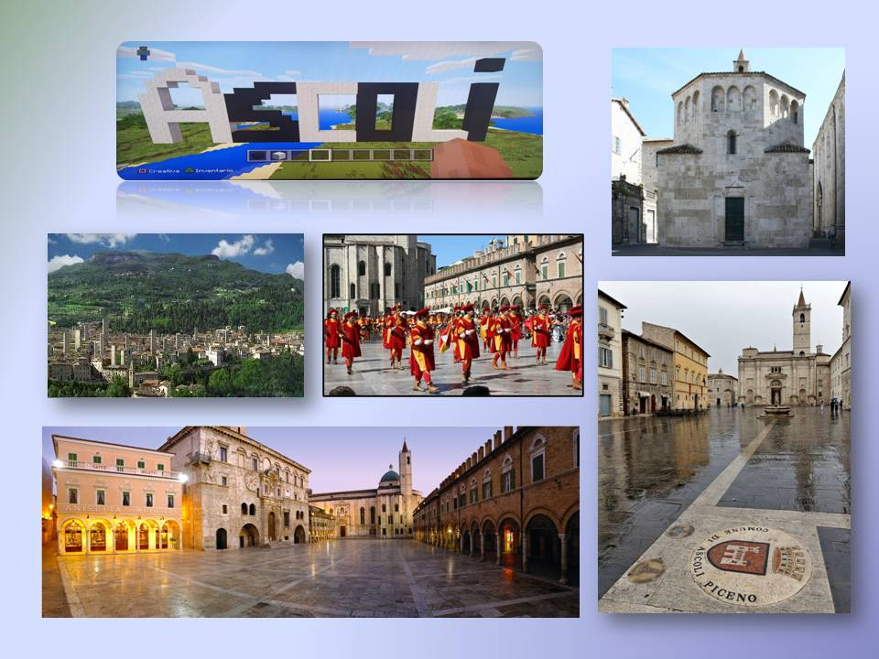
Slide 3 “VIRTUAL TOUR GUIDES”
VIRTUAL BUREAU IN ASCOLI
What do “VIRTUAL TOUR GUIDES” do?
VIRTUAL BUREAU IN LYMAN
Operate in Europe
Describe the place in which they live engaging visitors
Consolidate decision–making skills
Make realistic choices
Improve competences to face real life
https://youtu.be/BLUhaVon4zA

Slide 5
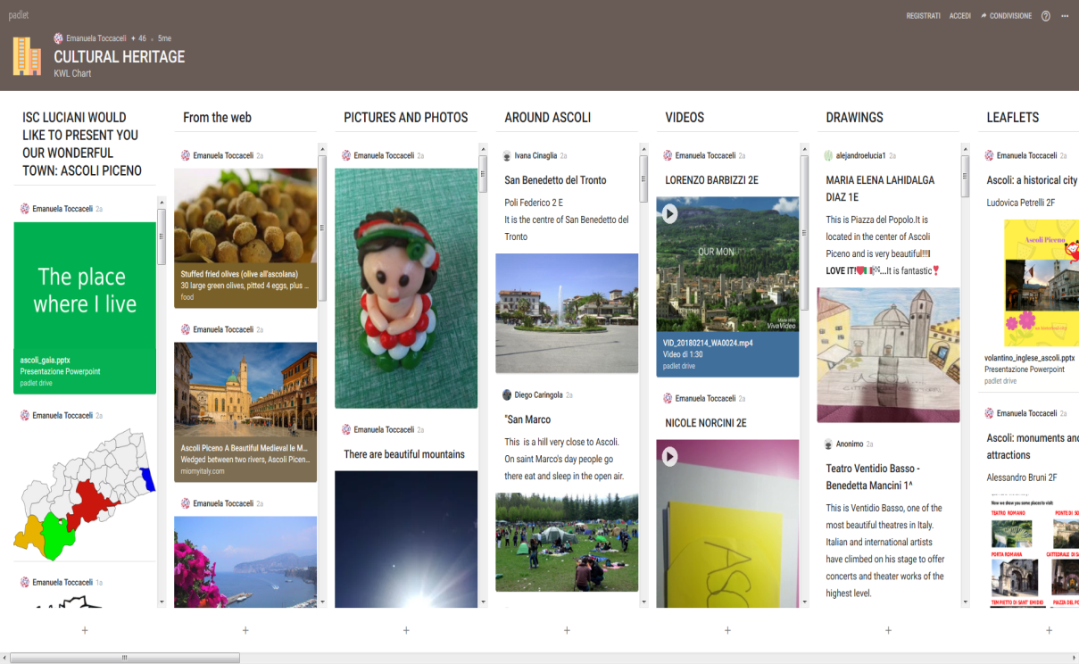
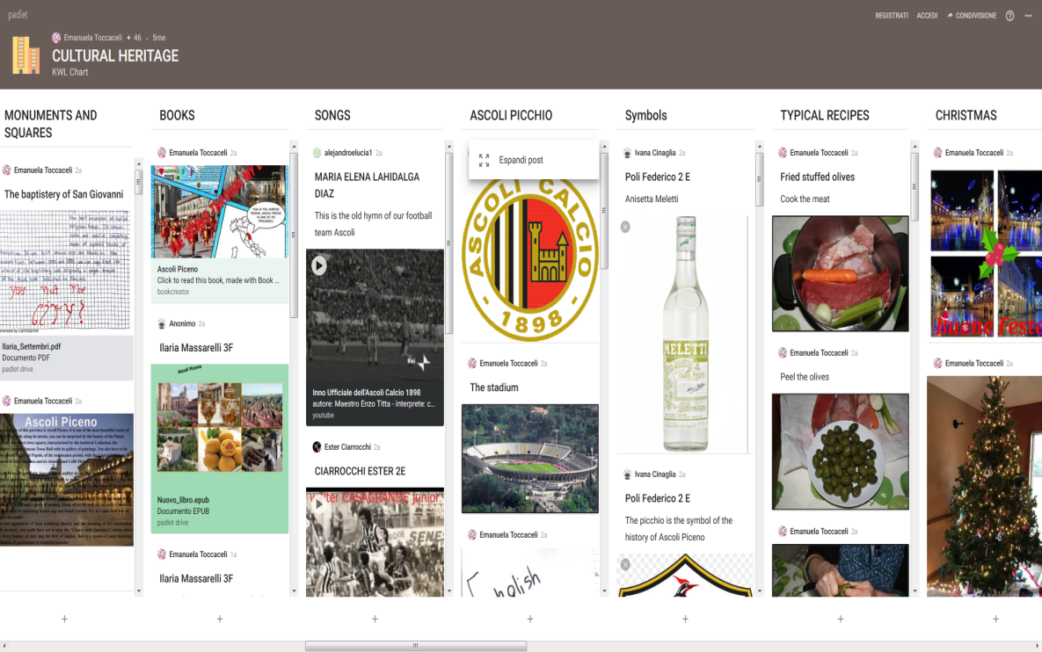
Slide 4 What do Virtual Tour Guides do?
PROMOTE THEIR IDENTITY AND TERRITORY THROUGH…..
– EBOOKS – LEAFLETS – IMAGES -ITINERARIES
https://it.padlet.com/emanuela_toccaceli_et/culturalheritage
OUR FINAL EBOOK
https://issuu.com/emanuelatoccaceli/docs/padlet-71tx2byq43s6-ilovepdf-compre

Slide 6
Slide 5 What do Virtual Tour Guides do?
THE MARCHE REGION
An example of ebook
https://ita.calameo.com/read/005821727d9cff6db0bdd?authid=e8Ov9TVNvRKc
MALASPINA PALACE
An example of leaflet
https://sway.com/BTzNmyVwTNb9UsRY?ref=Link&loc=play
AN EXAMPLE OF LEAFLET

Slide 7
BOOK CREATOR: ANOTHER EBOOK

Slide 8
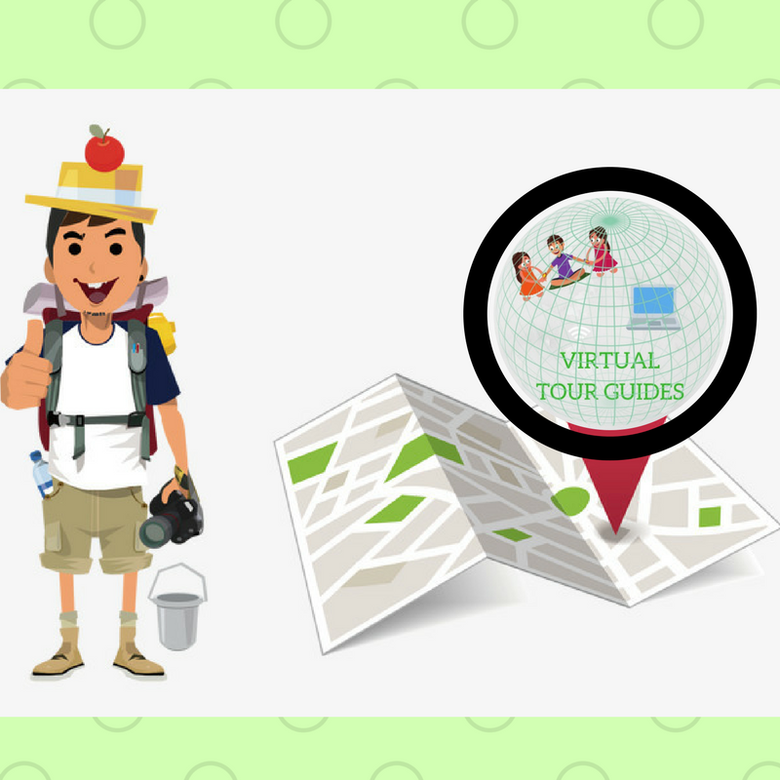
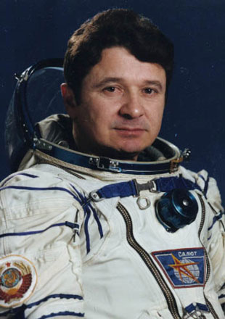
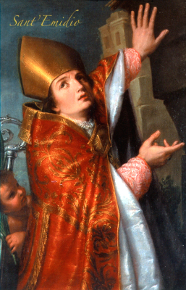
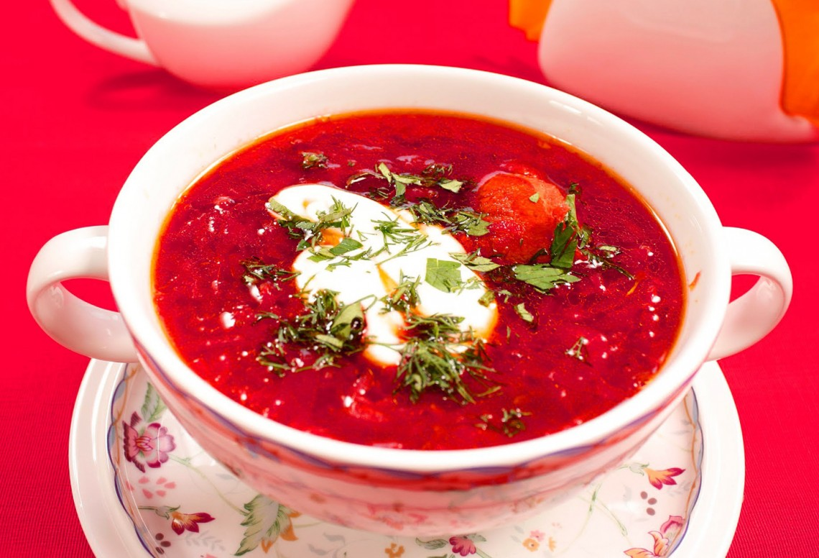
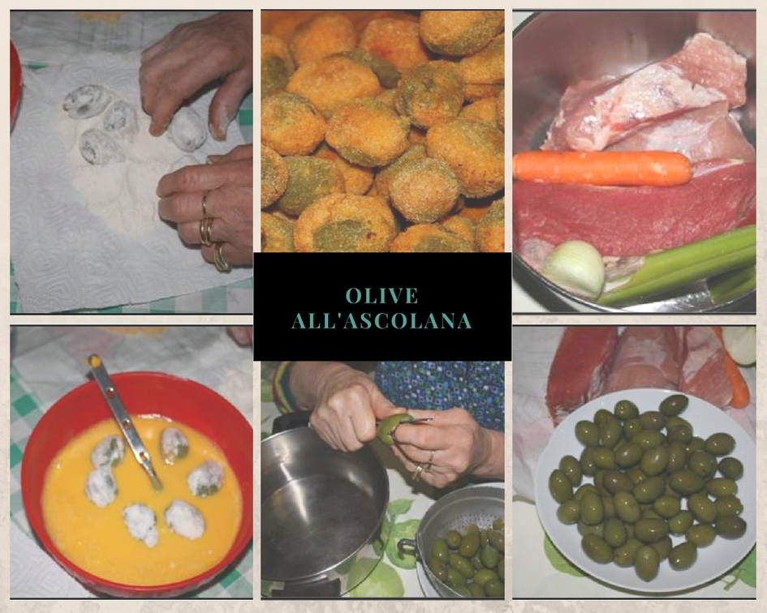
Slide 6 What do Virtual Tour Guides do ?”
Present Important people in…
LYMAN
ASCOLI PICENO
And share Traditional food…
LYMAN
ASCOLI PICENO
https://padlet.com/KateGordienko/fbltfa9i6y3k
https://padlet.com/emanuela_toccaceli_et/borninap
https://it.padlet.com/emanuela_toccaceli_et/recipe
28/09/2019

Slide 9
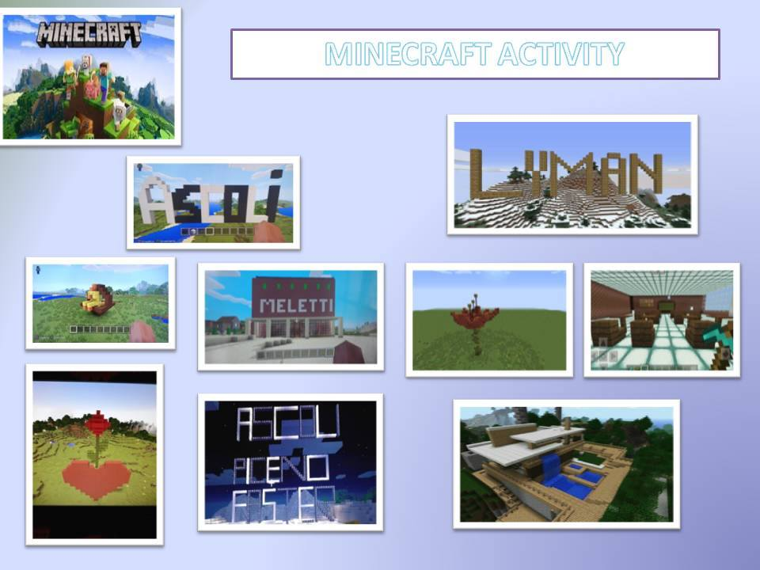
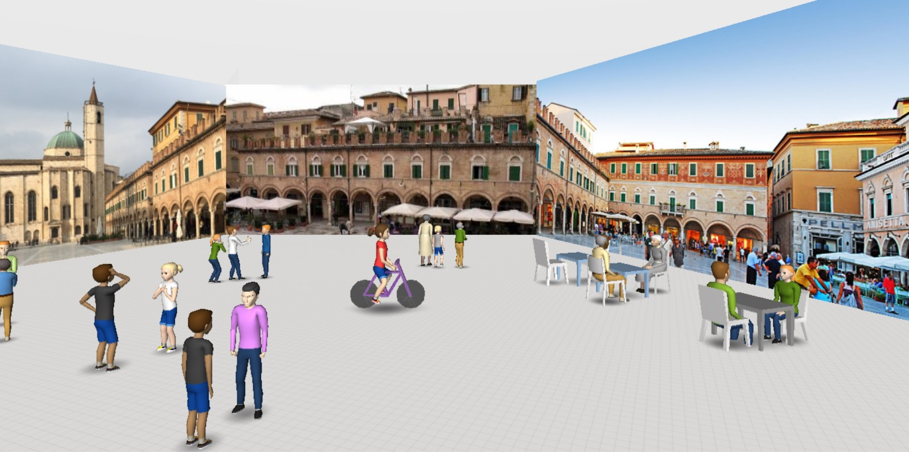
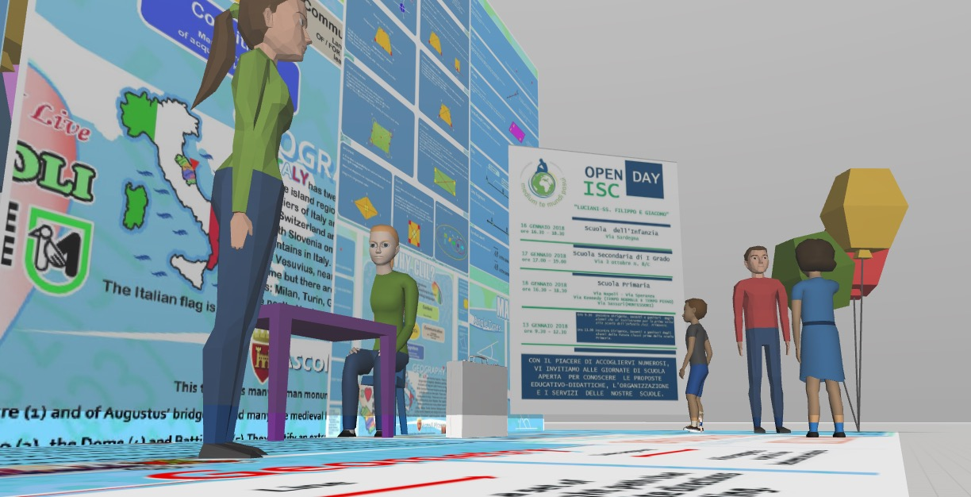
Slide 7 “VIRTUAL TOUR GUIDES”
Use new multimedia and virtual technology,
not in a passive way but in a position of learning by doing
experiment a different model of education in which they are the real innovators
28/09/2019

Slide 10
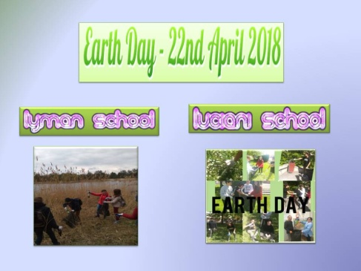
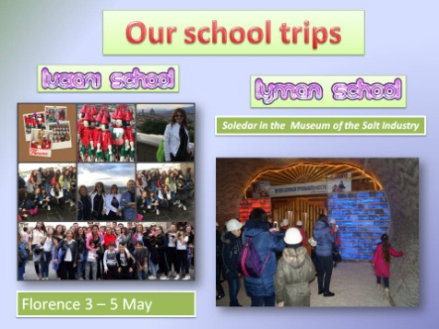
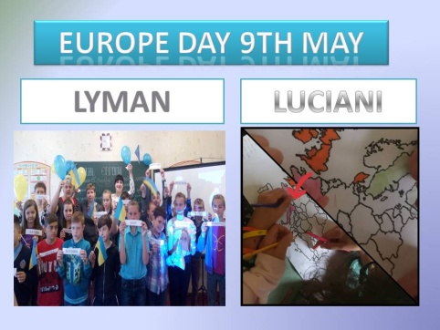
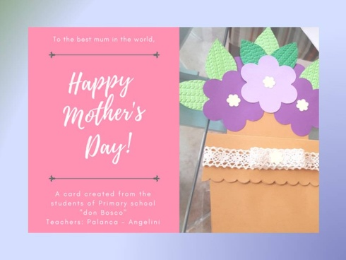
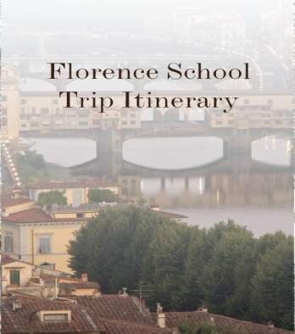
Slide 8 What do “Virtual Tour Guides” do?
combine the work of their school with that of others
Develop critical thinking while comparing other realities
https://sway.com/XJp1xWYm62nGeEeT?ref=Link&loc=play

Slide 11
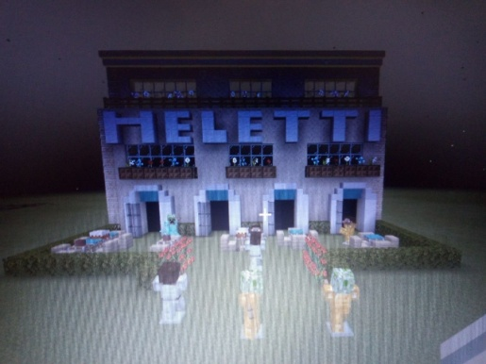
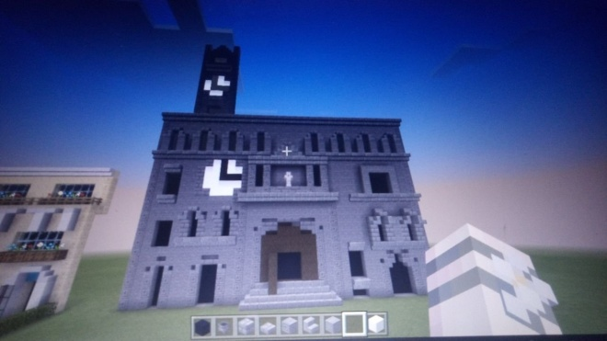
Slide 9 What do “VIRTUAL TOUR GUIDES” do?
partecipate in videoconferences to extend the learning experience
Beyond Classroom walls
OUR VIRTUAL EXCURSION
ASCOLI:
https://youtu.bOvQGhwFYe/Juo
https://youtu.be/SbZmtX_TMGQ
LYMAN: https://youtu.be/0VtZYZ4w36Y
https://youtu.be/os7nhKrm3CQ
28/09/2019

Slide 12
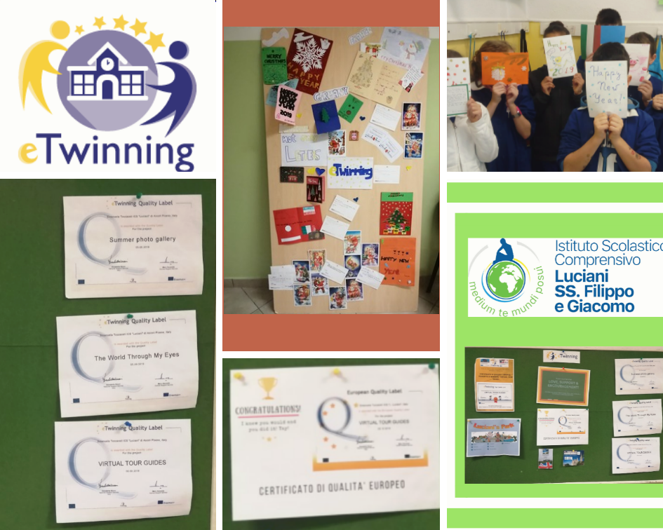
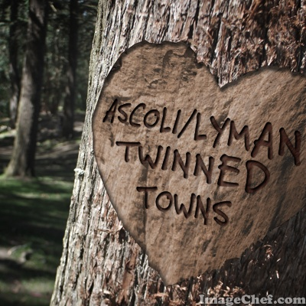
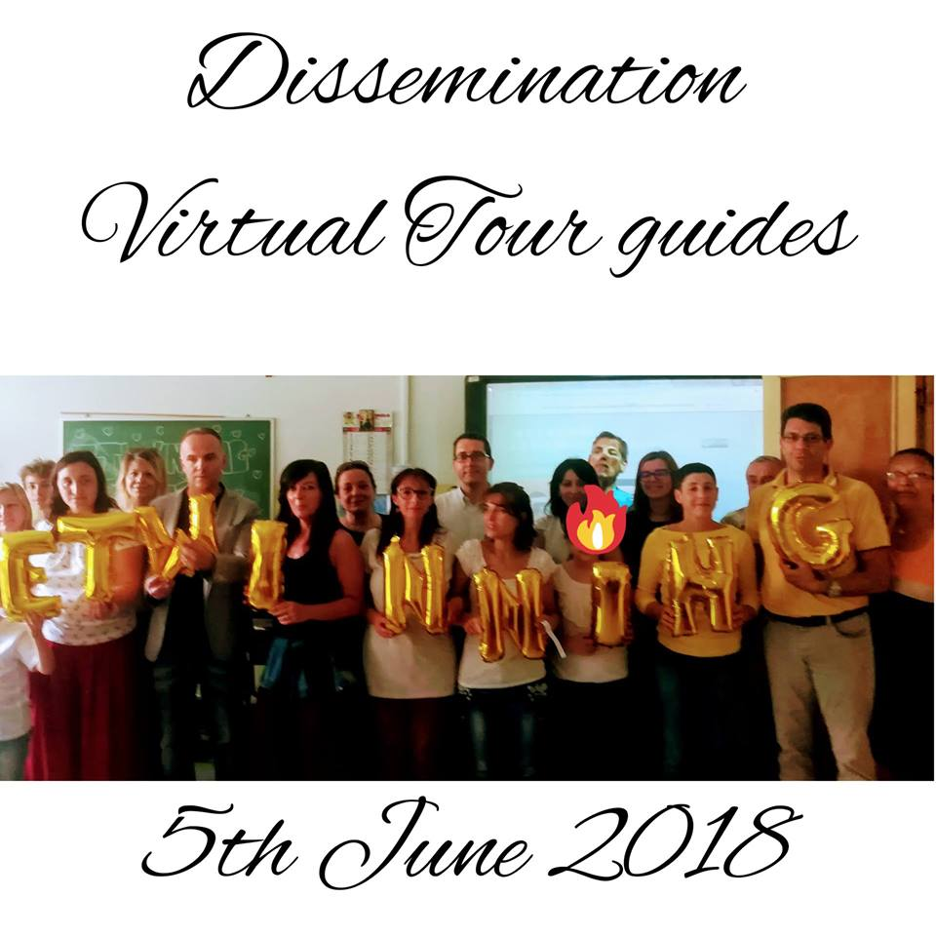
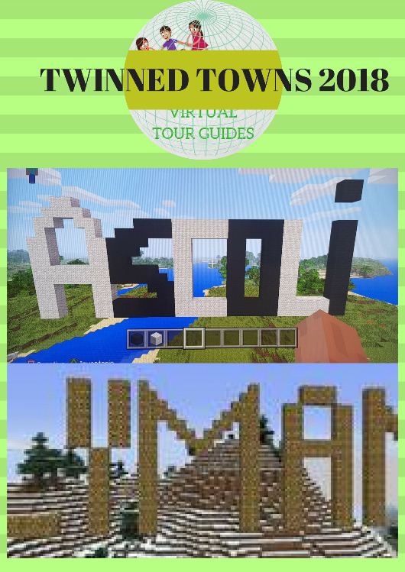
Slide 10 “VIRTUAL TOUR GUIDES”
LET’S KEEP IN TOUCH
EVALUATION & DISSEMINATION
28/09/2019

Slide 13
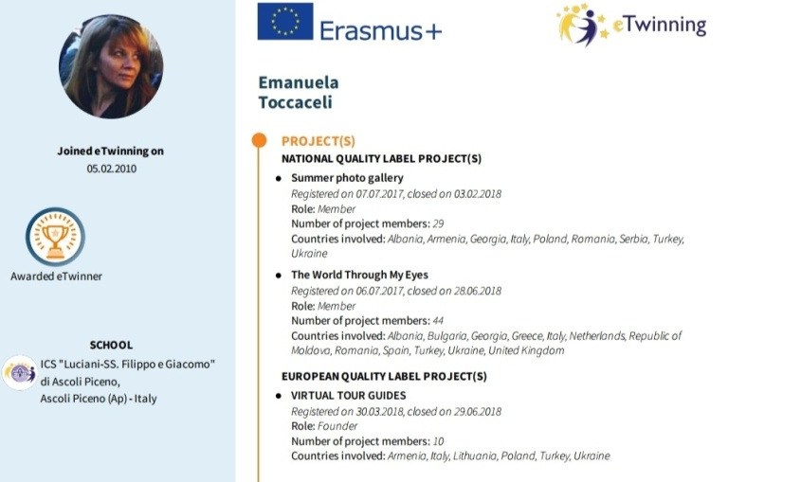
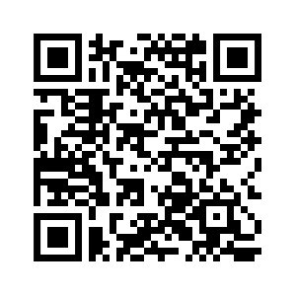
For further information about our projects:
https://www.isclucianiap.edu.it/
website
My email: emanuelatoccaceli@yahoo.it
Facebook page
https://www.facebook.com/emanuelatoccacelienglishteacher/?modal=admin_todo_tour
https://emanuelatoccaceliwixsitecomenglishteache.weebly.com/
https://emanuelatoccaceli.wixsite.com/englishteacher

Slide 14
https://youtu.be/-fgkUVlRT_s
And You say goodbye ….
… I say hello!
https://youtu.be/vS6WSoNDivk
28/09/2019

