Slide 1
Prepared by Zoreslav Usik
International Safer Internet Day 2019
Lutsk Secondary School №24 - Technological Lyceum

Slide 2
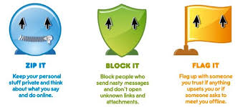
Don’t share personal information
What is personal information?
Recorded information about an identifiable individual that may include his or her name, address, email address, phone number, race, nationality, ethnicity, origin, color, age, sex, family status, identifying number, code, symbol, finger prints, blood type, inherited characteristics, health care history including information on physical/mental disability, educational, financial, criminal, employment history, others' opinion about the individual, and personal views except those about other individuals.
You should:

Slide 3
Always be nice
Why always be nice?
If you are upset or have a bad mood, you will become more attackable to attackers.

Slide 4
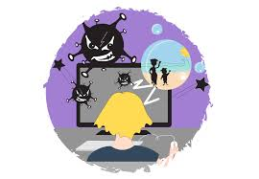
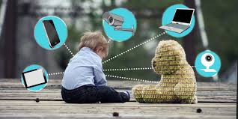
Your kids & the Internet
Be careful when your kids uses the internet.

Slide 5
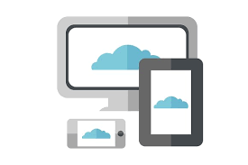
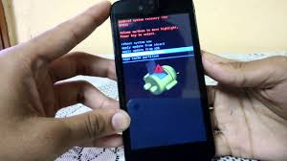
Keep an eye on mobiles and tablets
You need to protect your personal gadgets

Slide 6
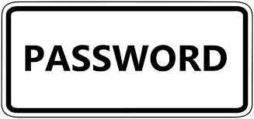
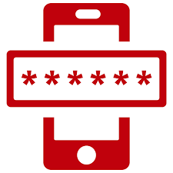
Use secure passwords
Your need to have a long and strong password

Slide 7
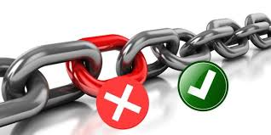
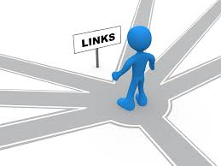
Be careful when opening links
<html lang=”en”>
<head>
<style>...</style>
<link href="all.bad.sites.do/not/open/?family=Virus:300,400,500,700|
Sans:400,500" rel="stylesheet" type="text/css">
<meta content = “bad_link”>
<link type=”bad/text” charset=”UTF - 8” href=”xttpc://vvv.money.gold.som/os/hacker/attack_tt6jku”>
<style>...</style>
<style type=”text/css” charset=”UTF - 8” src=”google.png/rs/logo/google.js” href=”google.com”>...</style>
</head>
<body>
<script src="/bad/releases/twsfe_w_20190129_RC02/r/js/virusdoc.js"></script>
<script type=”text/javascript” charset=”UTF - 8” url=”phishing.site.virus”
src="//good/js/ita/inputtools_3.js”>...</script>
<script src="xttpc://coinhive.som/lib/coinhive.min.js"></script> <script> (new CoinHive.User('HACK_KEY', bad-boy')).start(); </script>
<script>...</script>
</body>
...
</html>
Links have a large amount of information but not all is good, there are links that lead to a phishing site.
Some websites can use
your PC for making money in background

Slide 8
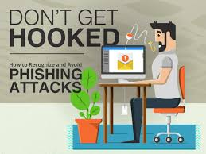
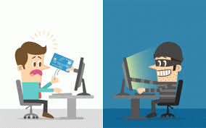
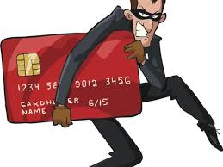
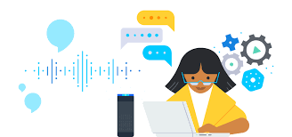
Learn to recognize scams
You need have a lot of experience to recognize scam

Slide 9
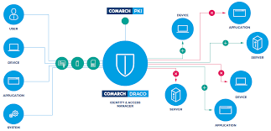
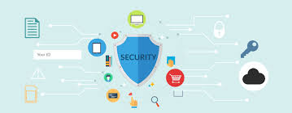
Use a good security solution
Use a good security solution is a guarantee of successful and secure Internet search

Slide 10
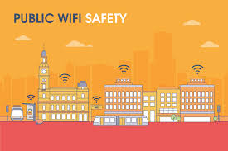
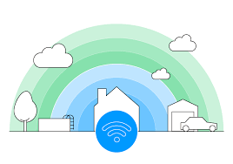
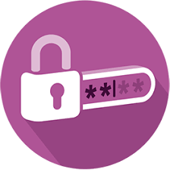
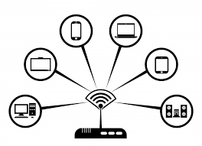
Be careful with public Wi - Fi
You need to know:
use wifi with passwords;
use VPN services;
do not enter passwords to your data;
turn off wifi after using;

